Slide 1

PRESENTED BY:
SAIKUMAR GANJI
SRINIVAS PERLA

Slide 2
AGENDA:
SOCKET PROGRAMMING IN PYTHON
WHAT ARE SOCKETS
USE OF SOCKETS
HOW TO ACHIEVE SOCKET PROGRAMMING PYTHON
WHAT IS A SERVER
WHAT IS A CLIENT
TCP SOCKETS
TRANSFERRING PYTHON OBJECTS

Slide 3
SOCKET PROGRAMMING IN PYTHON
Socket programming is a way of connecting two nodes on a network to communicate with each other. One socket(node) listens on a particular port at an IP, while the other socket reaches out to the other to form a connection. The server forms the listener socket while the client reaches out to the server.
They are the real backbones behind web browsing. In simpler terms, there is a server and a client.
Socket programming is started by importing the socket library and making a simple socket.
import socket
s = socket.socket(socket.AF_INET, socket.SOCK_STREAM)

Slide 4
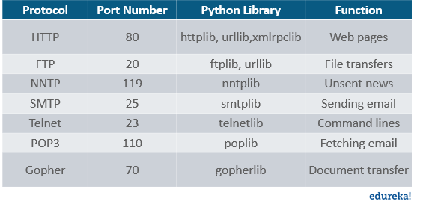
What are Sockets?
sockets are interior endpoints built for sending and receiving data. A single network will have two sockets, one for each communicating device or program. These sockets are a combination of an IP address and a Port. A single device can have ‘n’ number of sockets based on the port number that is being used. Different ports are available for different types of protocols. Take a look at the following image for more about some of the common port numbers and the related protocols:

Slide 5
USE OF SOCKETS:
Sockets are the backbone of networking. They make the transfer of information possible between two different programs or devices. For example, when you open up your browser, you as a client are creating a connection to the server for the transfer of information.
How to achieve Socket Programming in Python:
To achieve Socket Programming in Python, you will need to import the socket module or framework. This module consists of built-in methods that are required for creating sockets and help them associate with each other.
Some of the important methods are as follows:

Slide 6
METHODS | DESCRIPTION
socket.socket() | used to create sockets (required on both server as well as client ends to create sockets)
socket.accept() | used to accept a connection. It returns a pair of values (conn, address) where conn is a new socket object for sending or receiving data and address is the address of the socket present at the other end of the connection
socket.bind() | used to bind to the address that is specified as a parameter
socket.close() | used to mark the socket as closed
socket.connect() | used to connect to a remote address specified as the parameter
socket.listen() | enables the server to accept connections

Slide 7
What is server:
A server is either a program, a computer, or a device that is devoted to managing network resources. Servers can either be on the same device or computer or locally connected to other devices and computers or even remote. There are various types of servers such as database servers, network servers, print servers, etc.
Servers commonly make use of methods like socket.socket(), socket.bind(), socket.listen(), etc to establish a connection and bind to the clients.
Now let’s write a program to create a server.

Slide 8
Program:
import socket
s=socket.socket(socket.AF_INET, socket.SOCK_STREAM)
s.bind((socket.gethostname(),1234))
#port number can be anything between 0-65535(we usually specify non-previleged ports which are > 1023)
s.listen(5)
while True:
clt,adr=s.accept()
print(f"Connection to {adr}established")
#f string is literal string prefixed with f which
#contains python expressions inside braces
clt.send(bytes("Socket Programming in Python","utf-8 ")) #to send info to clientsocket

Slide 9
What is a Client?
A client is either a computer or software that receives information or services from the server. In a client-server module, clients requests for services from servers. The best example is a web browser such as Google Chrome, Firefox, etc. These web browsers request web servers for the required web pages and services as directed by the user. Other examples include online games, online chats, etc.
import socket
s=socket.socket(socket.AF_INET, socket.SOCK_STREAM)
s.connect((socket.gethostname(), 2346))
msg=s.recv(1024)
print(msg.decode("utf-8"))

Slide 10
TCP SOCKETS:
Create a socket object using socket.socket() and specify the socket type as socket.SOCK_STREAM. When you do that, the default protocol that’s used is the Transmission Control Protocol (TCP).
The Transmission Control Protocol (TCP):
Is reliable: packets dropped in the network are detected and retransmitted by the sender.
Has in-order data delivery: data is read by your application in the order it was written by the sender.

Slide 11
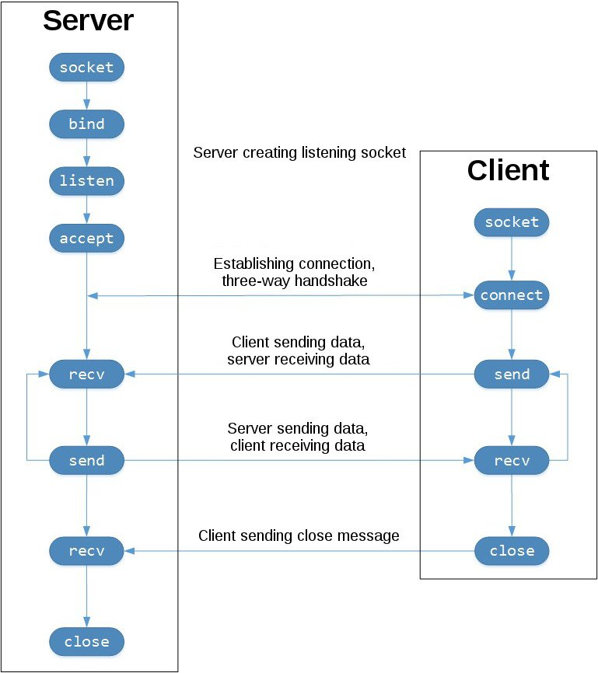

Slide 12
The left-hand column represents the server.
On the right-hand side is the client.
Starting in the top left-hand column, note the API calls the server makes to setup a “listening” socket:
socket()
bind()
listen()
accept()
A listening socket does just what it sounds like. It listens for connections from clients. When a client connects, the server calls accept() to accept, or complete, the connection.
The client calls connect() to establish a connection to the server and initiate the three-way handshake. The handshake step is important since it ensures that each side of the connection is reachable in the network, in other words that the client can reach the server and vice-versa. It may be that only one host, client or server, can reach the other.
In the middle is the round-trip section, where data is exchanged between the client and server using calls to send() and recv().
At the bottom, the client and server close() their respective sockets.

Slide 13
Transferring Python Objects:
Socket Programming in Python also allows you to transfer Python objects as well. These objects can be anything like sets, tuples, dictionaries, etc. To achieve this, you will need to import the pickle module of Python.
Python pickle module:
Python pickle module comes into picture when you are actually serializing or de-serializing objects in python.
import pickle
mylist=[1,2,'abc']
mymsg = pickle.dumps(mylist)
print(mymsg)
‘mylist’ is serialized using the dumps() function of the pickle module. Also make a note that the output starts with a ‘b’, meaning it’s converted to bytes. In socket programming, you can implement this module to transfer python objects between clients and servers.

Slide 14


